Slide 1
A Tale of Two Recessions
Comparing/Contrasting 2008/2009 Recession to 2020 Recession
Project and Presentation by Group 2:
Zahra Ahmadi, Sumeet Maheshwari,
Brian Remite, Bryan Wilson
Notes:
Quick intro to project (Bryan W. speaks)- Then each group member introduces themselves (All speak)

Slide 2
Background Information & Hypothesis
Recessions
Narrowing the Focus
Hypothesis
We have chosen to focus on the two most recent recessions that pertain to the U.S. economy.
2008/2009 (Housing crisis)
2020 (COVID-19 pandemic)
In this study, we narrowed our research to 3 month time-periods for two reasons:
The 2020 recession only has 3 months of relevant, verified data.
To keep the focus of our research on equal time spans.
The 2020 recession has been worse statistically, in terms of the value lost in the stock market ( % & $ ), as well as unemployment rate. (% and total pop. unemployed)
Notes:
Overview of project purpose, timespan focused on, and state hypothesis. (Bryan W. speks)

Slide 3
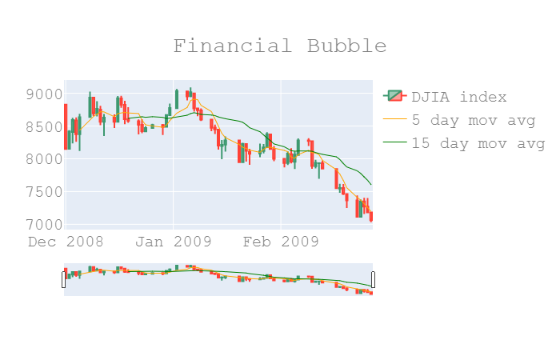
Stock Market Graph (2008-2009)

Slide 4
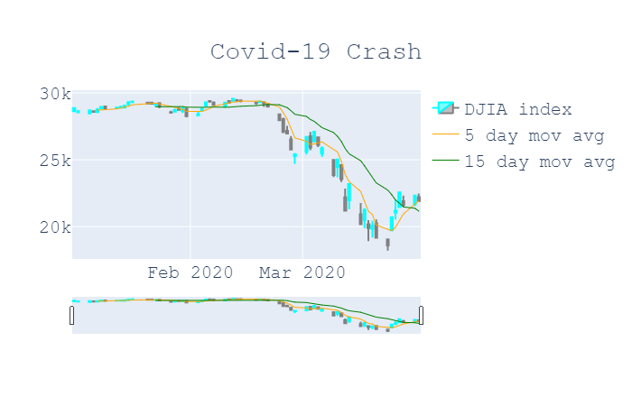
Stock Market Graph (2020)

Slide 5
Most Signifcant Rates of Change for Recessions
2008-09: Dates [mm/dd/yy-mm/dd/yy]
Percentage Drop:
Rate of Change(Slope):
2020: Dates [mm/dd/yy-mm/dd/yy]
Percentage Drop:
Rate of Change(Slope):

Slide 6
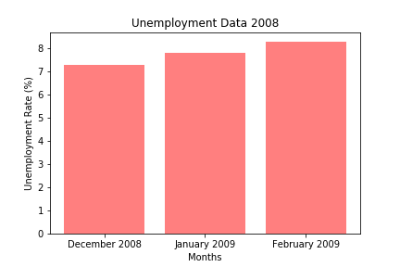
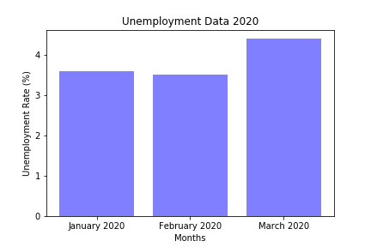
Unemployment Graphs

Slide 7
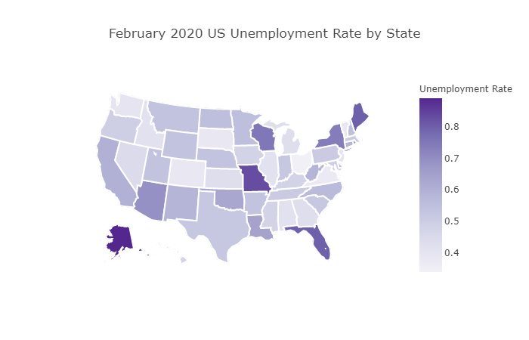
Heatmap

Slide 8
Important Fact Regarding
2020 Unemployment Data
Due to the ongoing nature of the 2020 recession, the most up-to-date (official) unemployment data only goes through March 2020.
According to the most recent reports, the U.S. is poised to shatter the historical unemployment rate high.
**Prediction models are showing a very significant increase in unemployment rate in the next few months.
**Source for projection data listed in works cited slide/README.md
Notes:
Prediction Info: April 2020 (9.5%), May 2020 (12.5%), and June (15%).

Slide 9
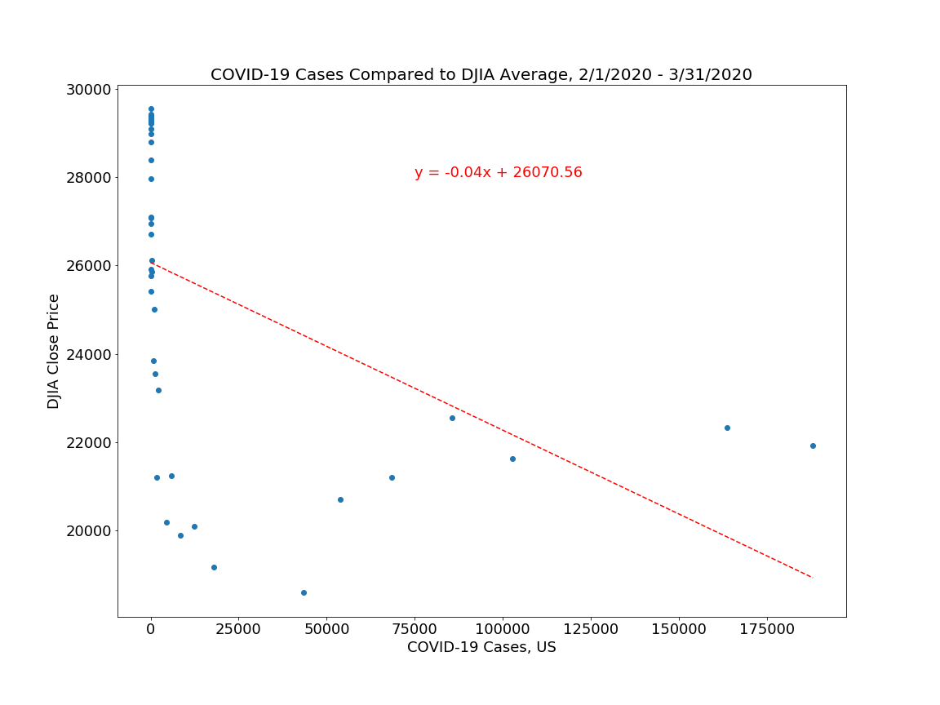
Linear Regression of Covid-19 Cases and DJIA Average
R-squared = 0.21052 [21.05%]
P value = 0.00255 [00.03%]
R-squared -This value indicates that this linear regression accounts for approximately 20% of the variation around its mean within the data, and therefore the correlation is most likely not linear.
P-value
-There is less than a 1% chance that the variation is random.
Notes:
Shows relationship between Stock Market drop and Covid-19 Case Count. (Brian R. speaks- refer )

Slide 10
Transition to “Spotlight” Companies

Slide 11
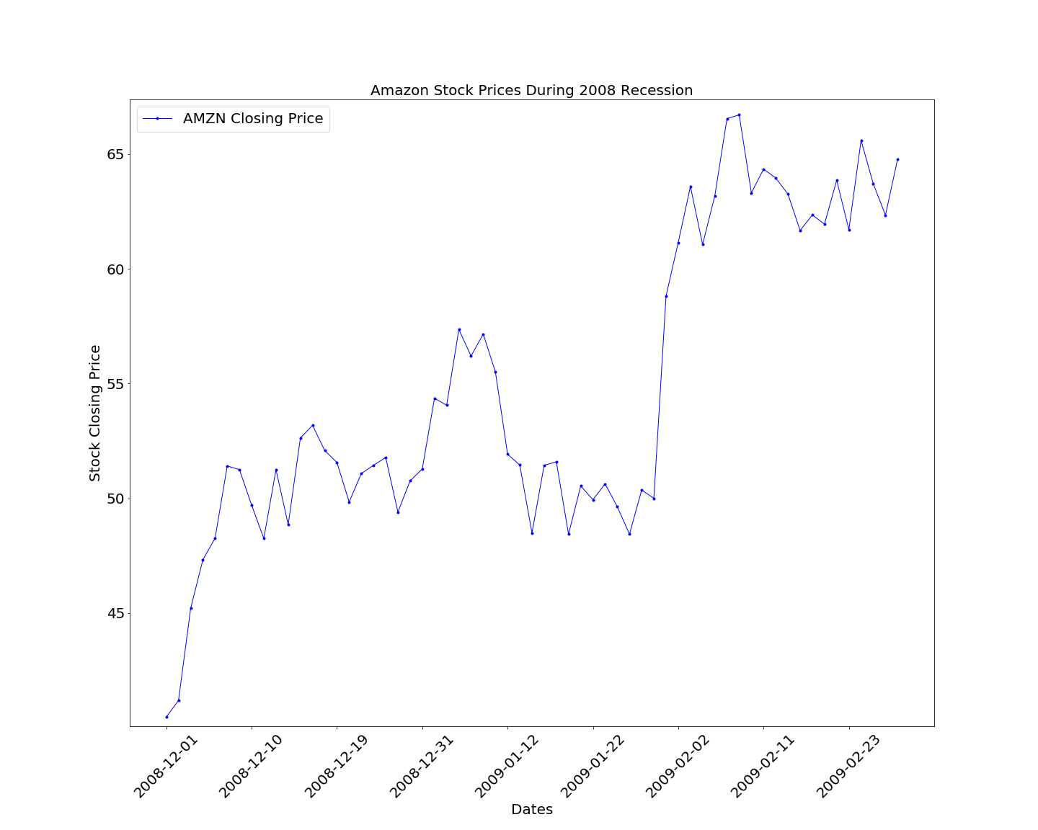
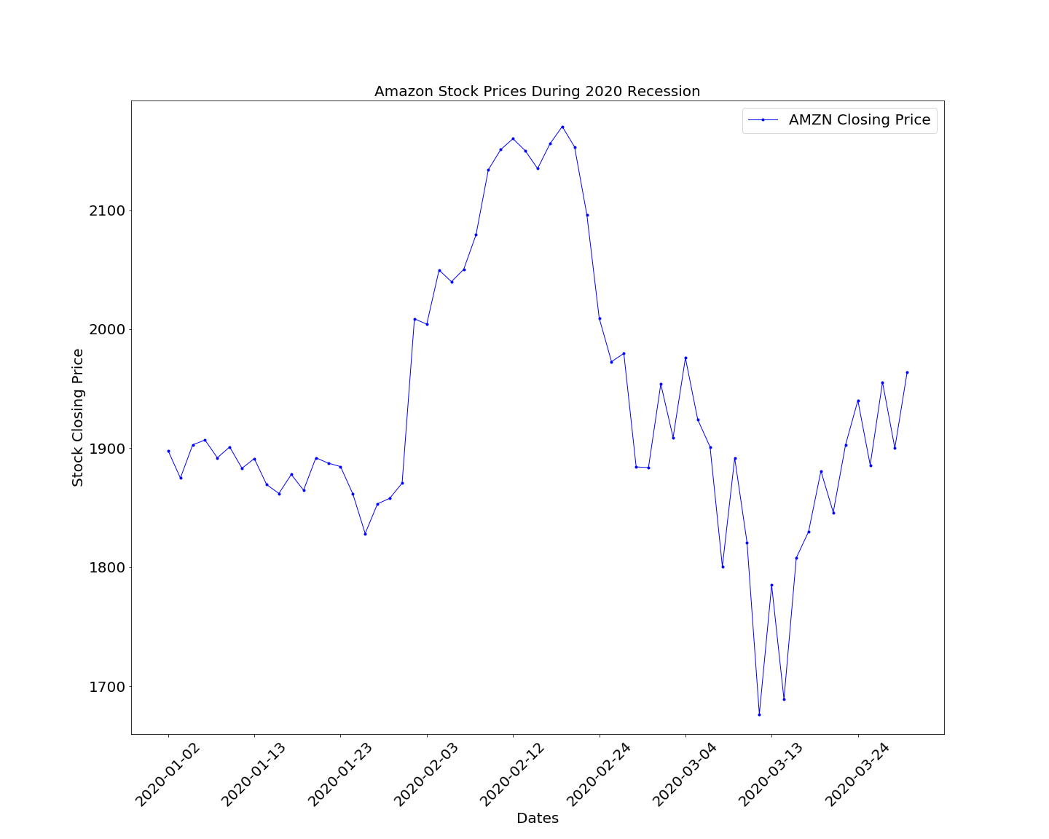
Amazon (AMZN)
2008-2009 Recession
Amazon (AMZN)
2020 Recession

Slide 12
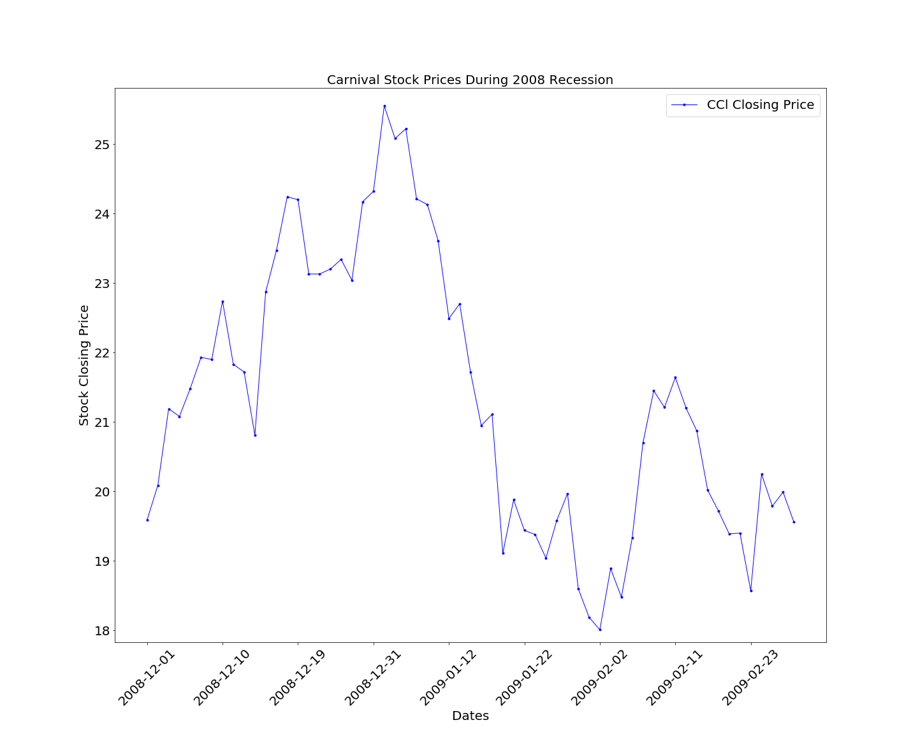
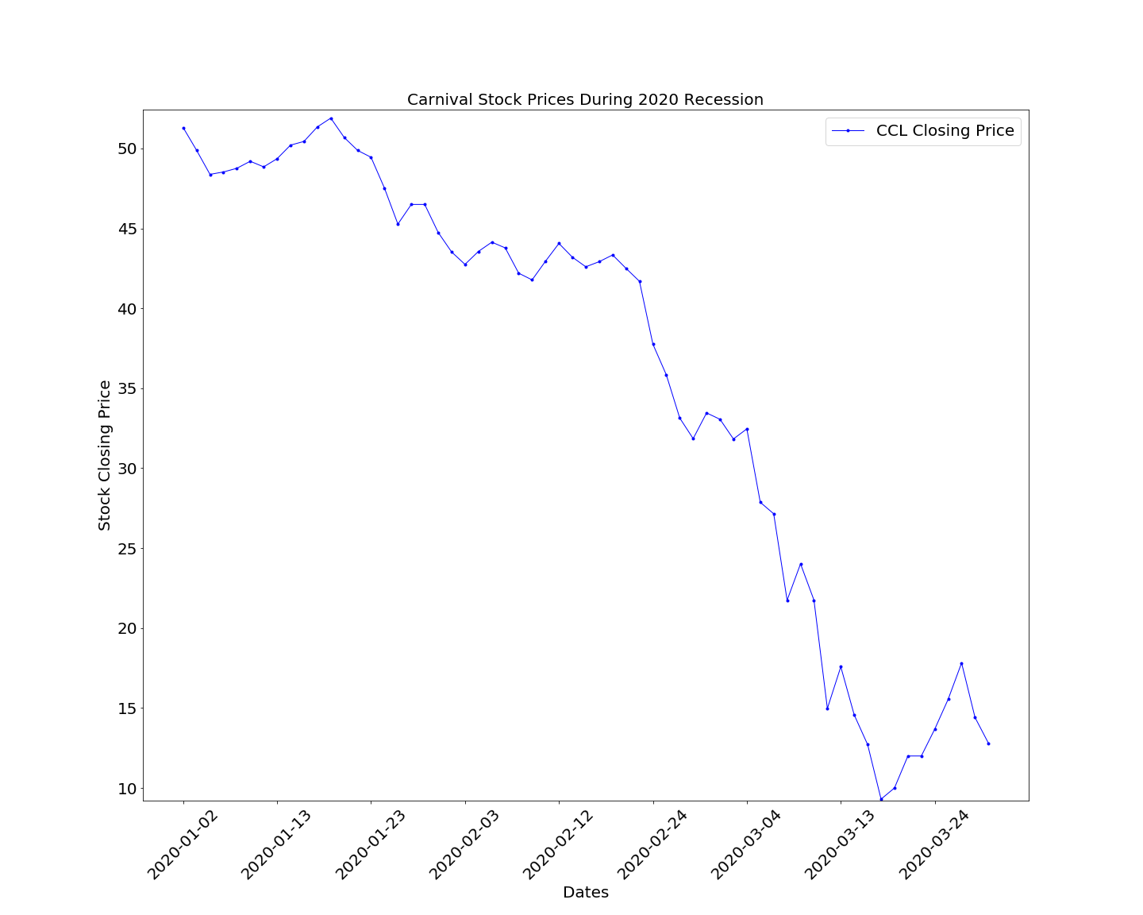
Carnival (CCL)
2008-2009 Recession
Carnival (CCL)
2020 Recession

Slide 13
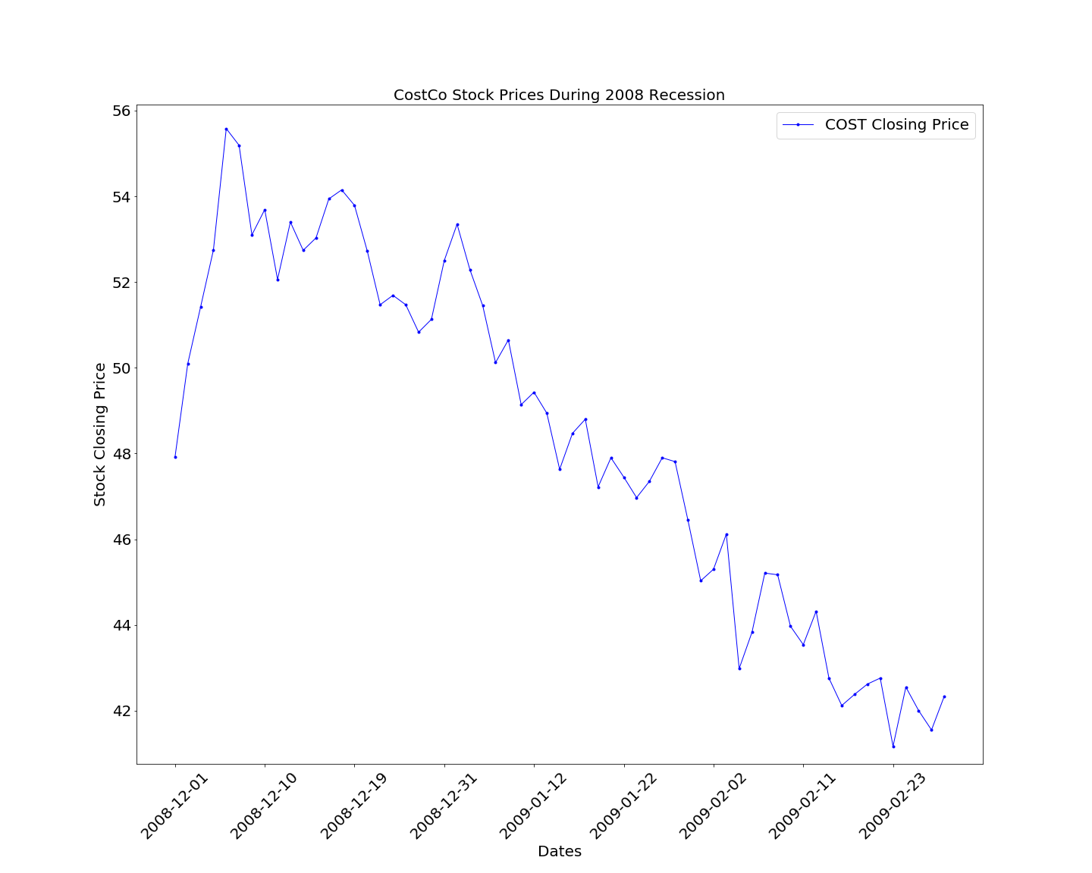
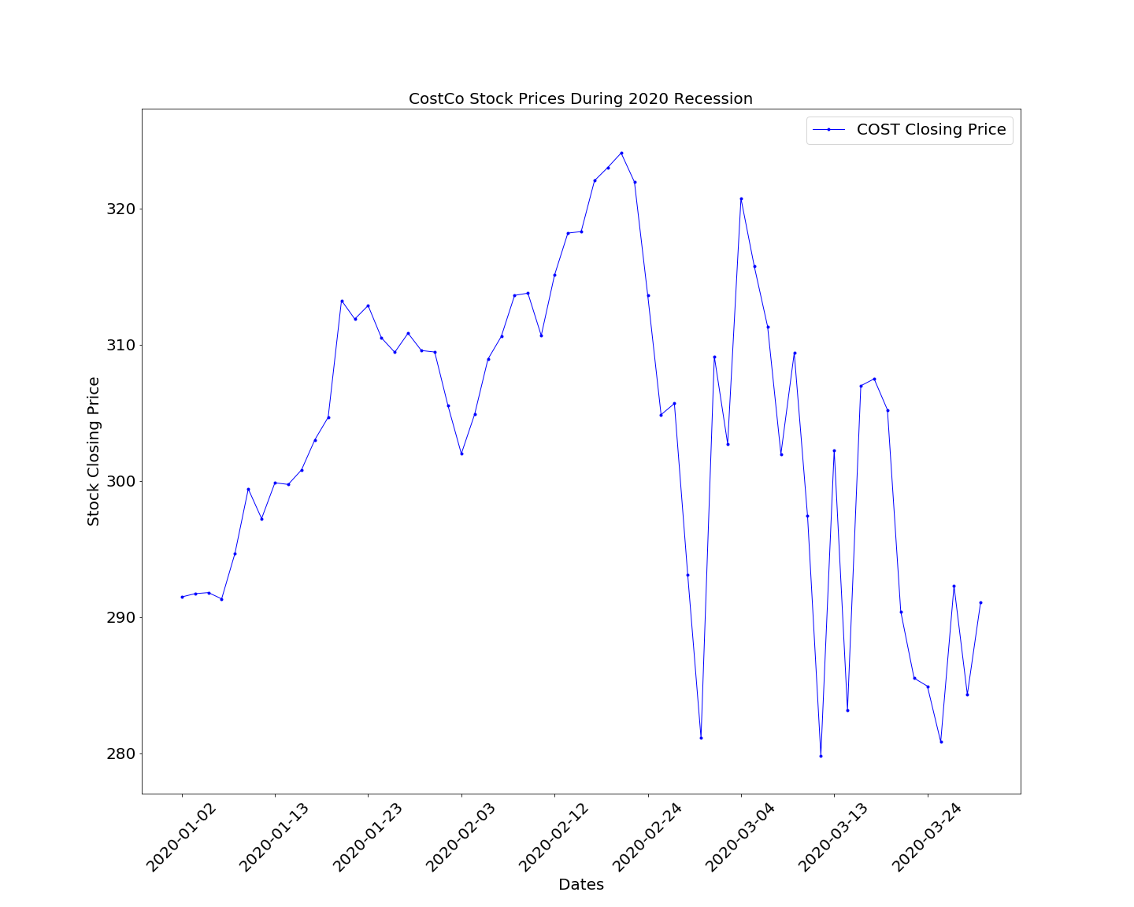
Costco (COST)
2008-2009 Recession
Costco (COST)
2020 Recession

Slide 14
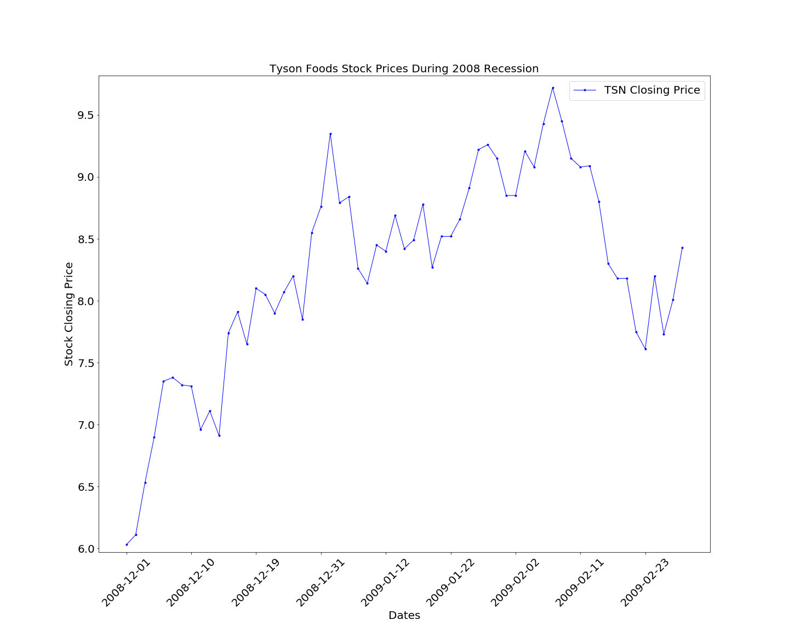
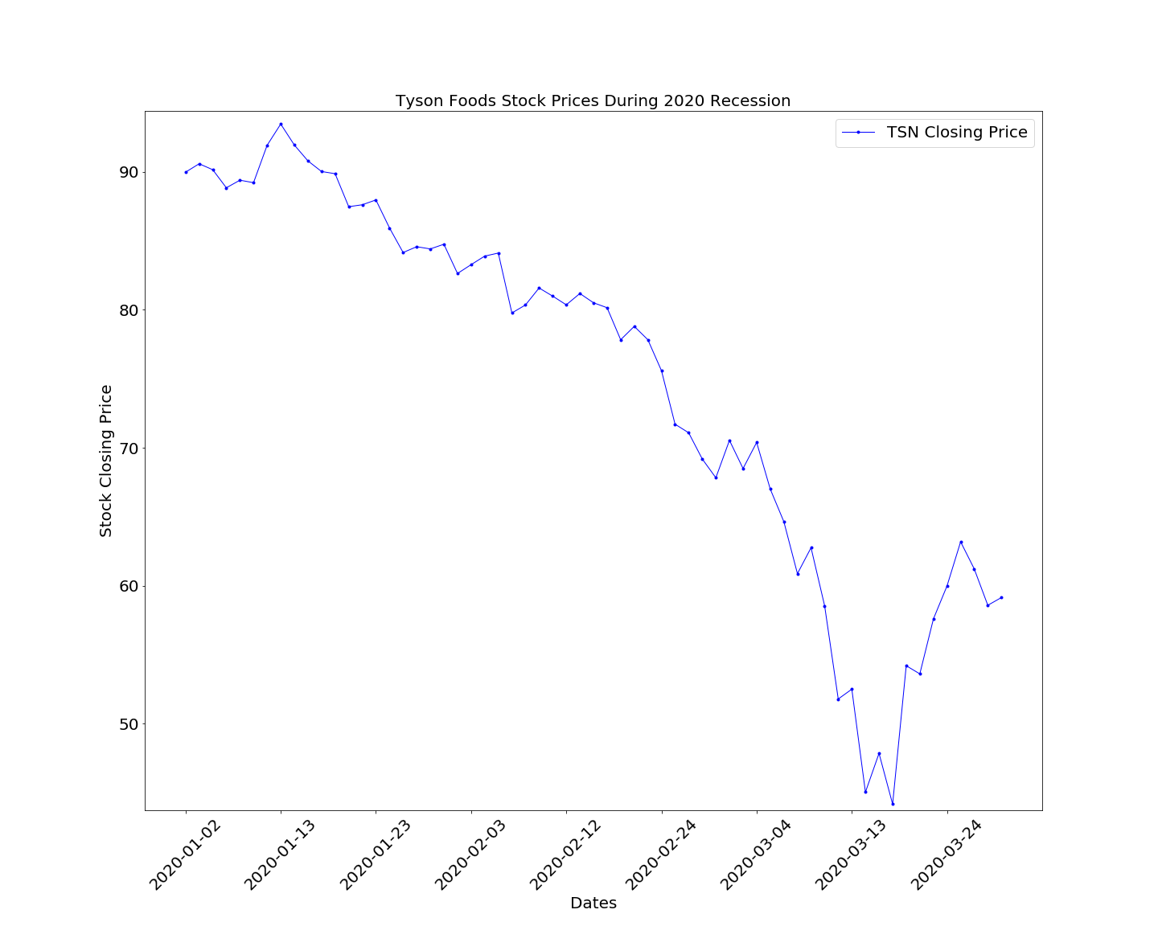
Tyson Foods (TSN)
2008-2009 Recession
Tyson Foods (TSN)
2020 Recession

Slide 15
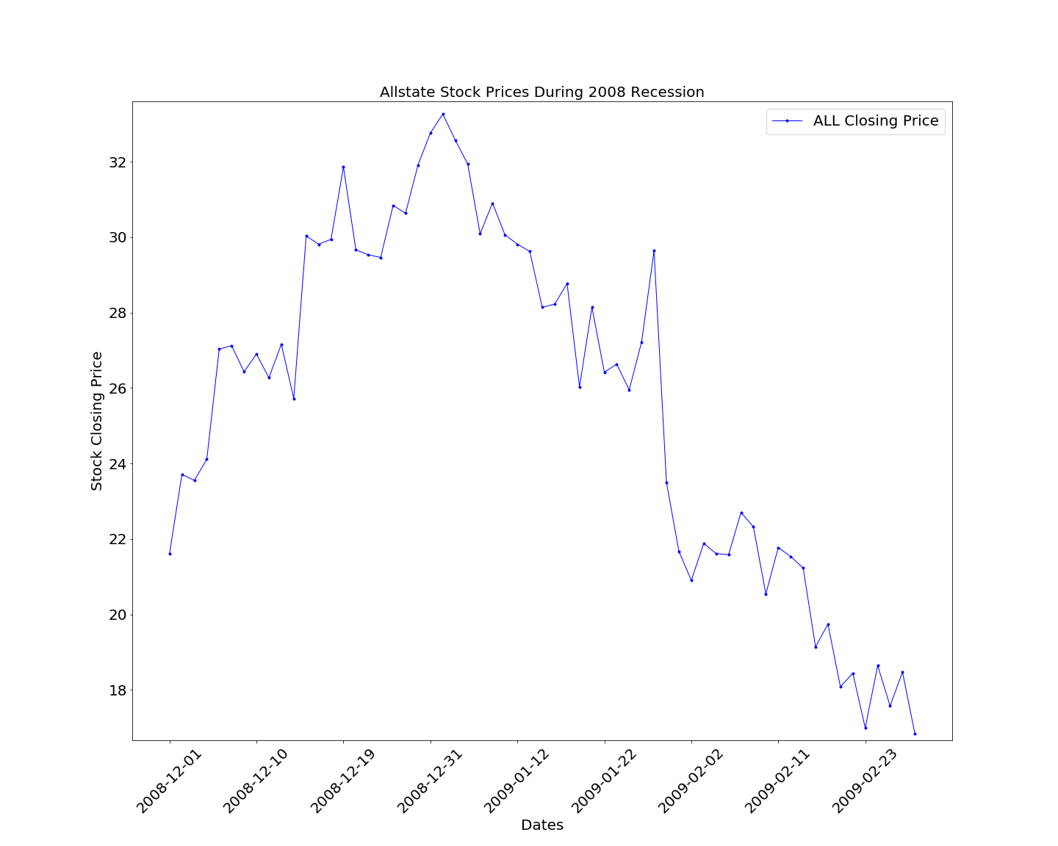
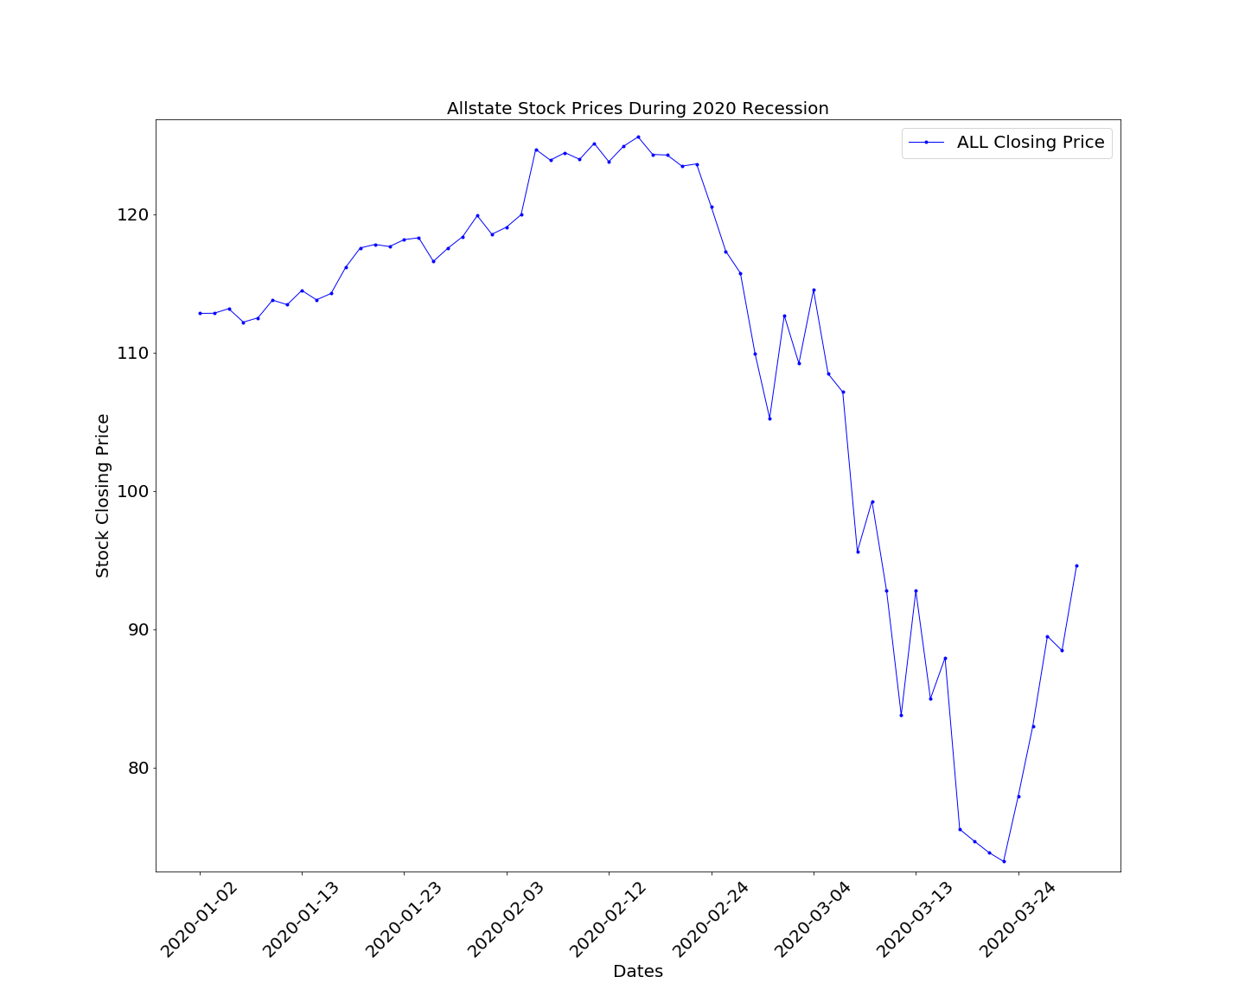
AllState (ALL)
2008-2009 Recession
AllState (ALL)
2020 Recession

Slide 16
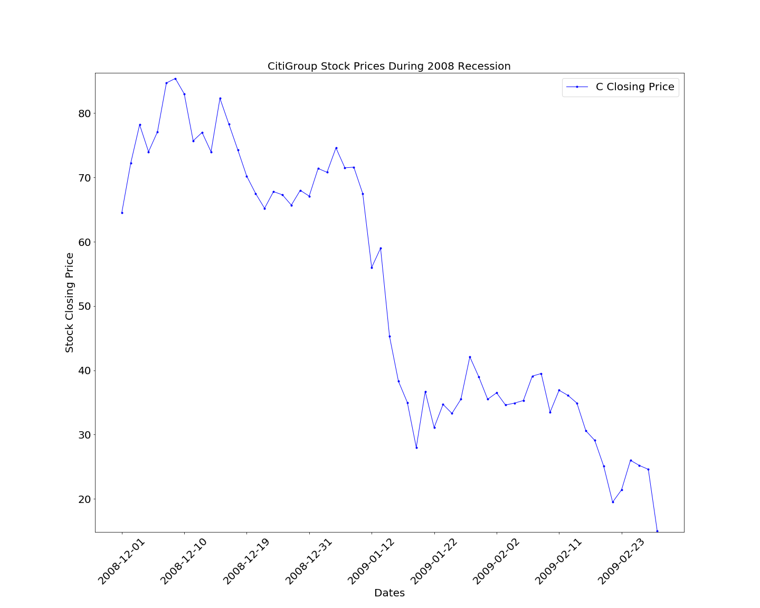
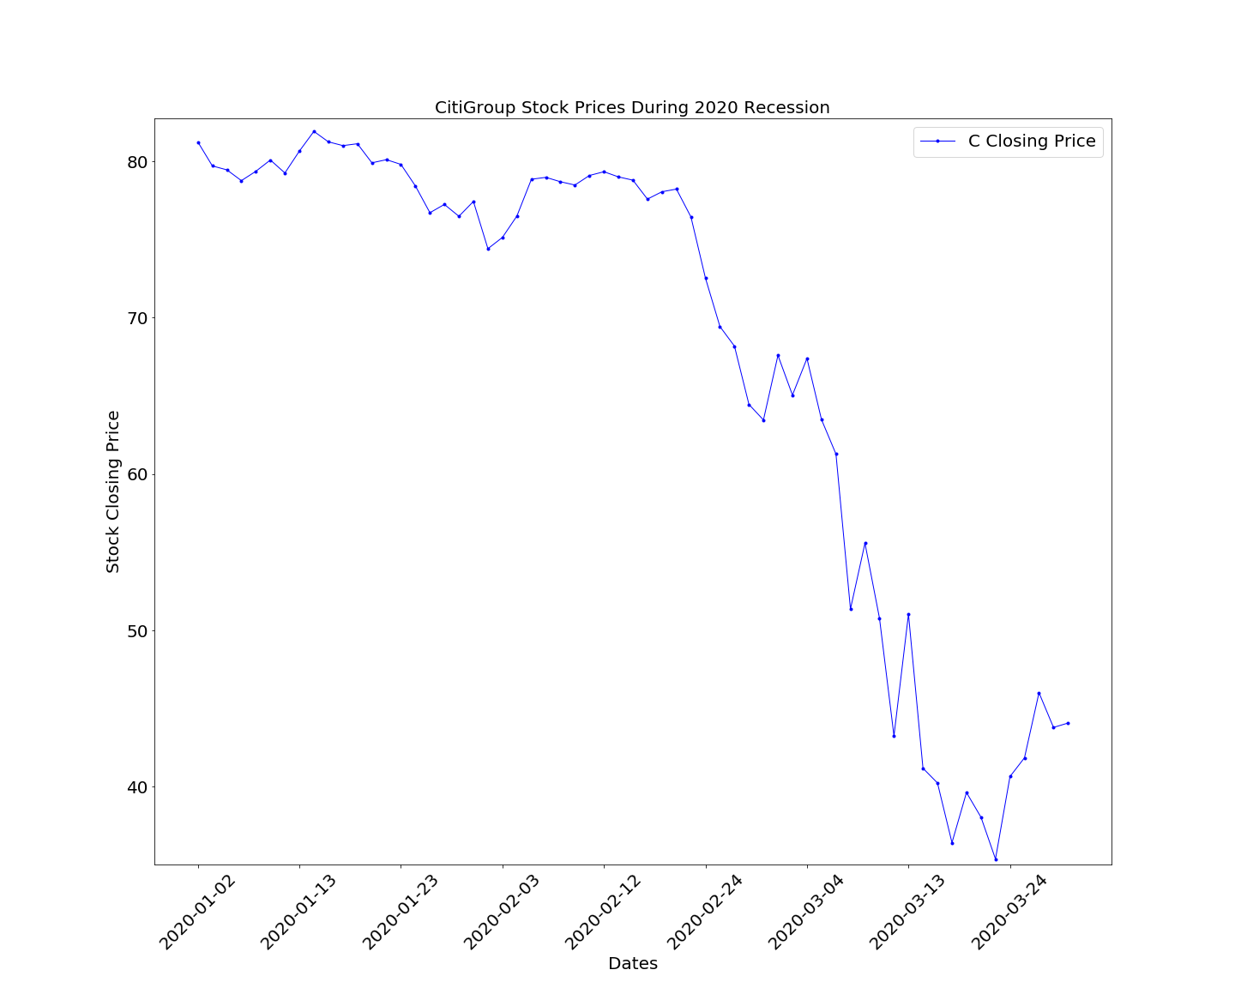
Citi Bank (C)
2008-2009 Recession
Citi Bank (C)
2020 Recession

Slide 17
Conclusion
The linear regression plot of the DJIA vs. COVID cases showed that there was a P-value of .002, meaning that there is less than a 1% chance of the variation being random, however the R-squared value was .20, meaning that there was approzimately 20% of the variation around the mean within the data. This shows us that there is a correlation, but not a linear correlation between those two data sets.
Our data on unemployment is incomplete, as the unemployment rate for April is as-of-yet unavailable. The data through March showed a trend towards correlation, however there is preliminary April data that shows the number of unemployed will skyrocket by the end of this month.
Based on the time period we have available to us for COVID-19,with only 3 months of complete data, there is a trend towards showing that our hypothesis was in fact correct.
However, at this time, we can not make a definitive conclusion due to the fact that the 2020 recession is ongoing, and we would need the data for the whole recession to do so.

Slide 18
Research data sources (Works Cited)

Slide 19
Questions?

